Slide 1
AI: Representation and Problem Solving
Classical Planning
Instructors: Pat Virtue & Stephanie Rosenthal
Slide credits: Reid Simmons, Manuela Veloso

Slide 2
Announcements
P3 out!
Sorry it is late. Due 3/7.
Can submit 3/8 without penalty
Can submit 3/9 with 1 late day
No submissions later than 3/9
HW6 out soon!

Slide 3
Planning, Thus Far
Goal States
completely specified
Goal Statements
partially specified
Preference models
objective function
Increasing Generality

Slide 4
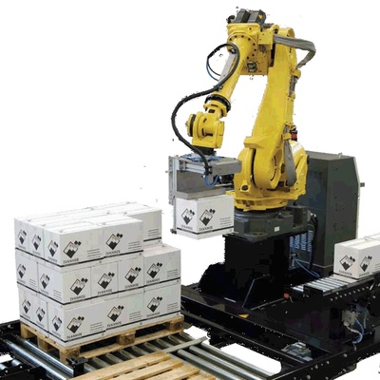
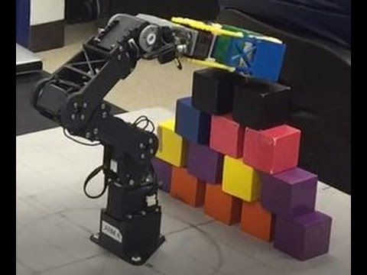

Robot Block Stacking
Start state: A, B, C on table
Goal: Block B on C and C on A
Actions: ?

Slide 5
Modeling Block Stacking States
Robot Arm
A
B
C
Start state: A, B, C on table
Goal: Block B on C and C on A
Actions: ?

Slide 6
Goals in the World
Goal States
completely specified
Goal Statements
partially specified
Preference models
objective function
Increasing Generality

Slide 7
Block Stacking States

Slide 8
Block Stacking States

Slide 9
Block Stacking States

Slide 10
Block Stacking States

Slide 11
Block Stacking States

Slide 12
States are Informationless
S1
S2
S3
S4
S5
S6
S7
S8
S9
S10
S11
S12
S13
S14
S15
S16
S17
S18
S19
S20
S21
S22
Notes:
This is a familiar data structure – a graph

Slide 13
Initial and Goal States

Slide 14
Plan from Initial to Goal State

Slide 15
Goals in the World
Goal States
completely specified
Goal Statements
partially specified
Preference models
objective function
BFS, DFS, A*
Increasing Generality

Slide 16
Goals in the World
Goal States
completely specified
Goal Statements
partially specified
Preference models
objective function
BFS, DFS, A*
Increasing Generality

Slide 17
Goals in the World
Goal States
completely specified
Goal Statements
partially specified
Preference models
objective function
BFS, DFS, A*
CSP, LP, IP
Increasing Generality

Slide 18
CSP for Blocks World
Goal: Block B on C and C on A
Constraint Satisfaction Problem:
Height(B) > Height(C)
Height(C) > Height(A)

Slide 19
Goals in the World
Goal States
completely specified
Goal Statements
partially specified
Preference models
objective function
BFS, DFS, A*
CSP, LP, IP
Increasing Generality

Slide 20
Goals in the World
Goal States
completely specified
Goal Statements
partially specified
Preference models
objective function
BFS, DFS, A*
CSP, LP, IP
Increasing Generality

Slide 21
Goals in the World
Goal States
completely specified
Goal Statements
partially specified
Preference models
objective function
BFS, DFS, A*
Logic
CSP, LP, IP
Increasing Generality

Slide 22
Logical Agents
Create a Knowledge Base
Symbols
Implications

Slide 23
Logical Agents
Create a Knowledge Base
Symbols – each is true or false
Implications – conjunctions imply new info

Slide 24
Symbolic Descriptions
Every state has the same objects
Properties and relationships of those objects change (i.e., locations)
Define states as set of symbols that represent whether those properties are true

Slide 25
Logical Agents
Create a Knowledge Base
Symbols
Robot Arm
A
B
C

Slide 26
Logical Agents
Create a Knowledge Base
Symbols
A-on-Table A-In-Hand
B-on-Table B-In-Hand
C-on-Table C-In-Hand
Hand-Empty
A-on-B B-on-A
A-on-C C-on-A
B-on-C C-on-B
Robot Arm
A
B
C

Slide 27
Logical Agents
Create a Knowledge Base
Symbols
A-on-Table A-In-Hand
B-on-Table B-In-Hand
C-on-Table C-In-Hand
Hand-Empty
A-on-B B-on-A
A-on-C C-on-A
B-on-C C-on-B
Robot Arm
A
B
C

Slide 28
Logical Agents
Create a Knowledge Base
Implications
What are the implications of
A-on-Table[t]?
Robot Arm
A
B
C

Slide 29
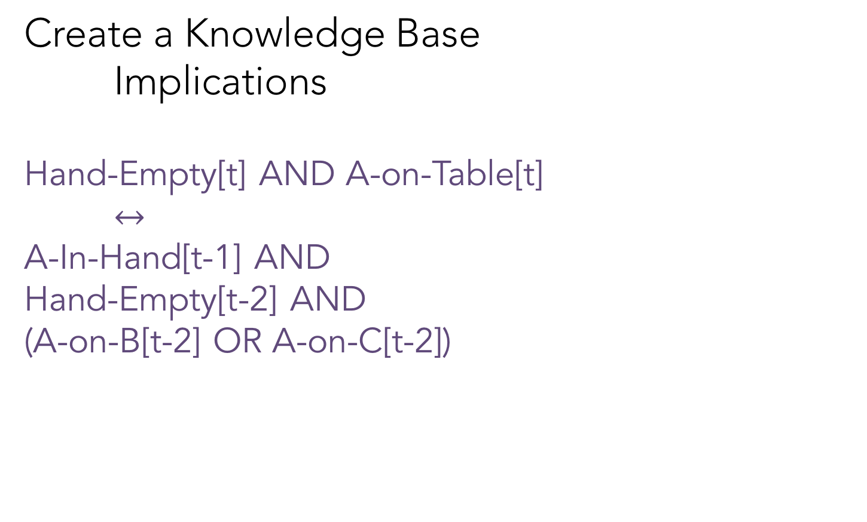
Logical Agents
Create a Knowledge Base
Implications
Hand-Empty[t] AND A-on-Table[t]
$↔$
A-In-Hand[t-1] AND
Hand-Empty[t-2] AND
(A-on-B[t-2] OR A-on-C[t-2])
Robot Arm
A
B
C

Slide 30
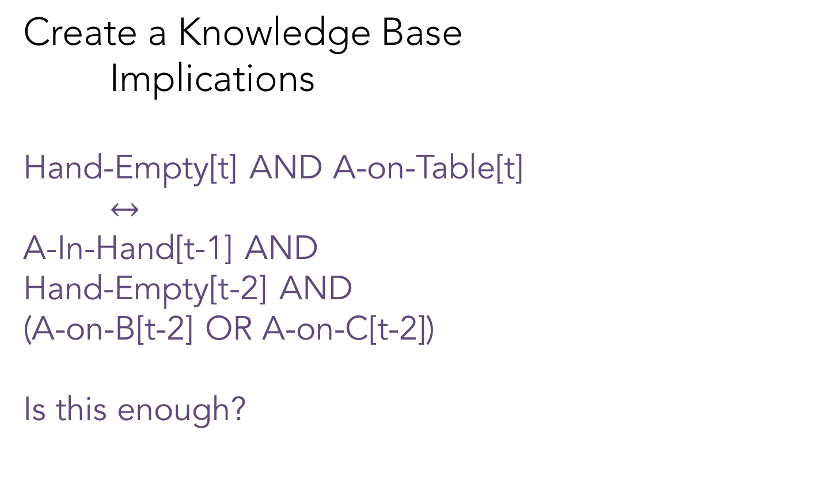
Logical Agents
Create a Knowledge Base
Implications
Hand-Empty[t] AND A-on-Table[t]
$↔$
A-In-Hand[t-1] AND
Hand-Empty[t-2] AND
(A-on-B[t-2] OR A-on-C[t-2])
Is this enough?
Robot Arm
A
B
C

Slide 31
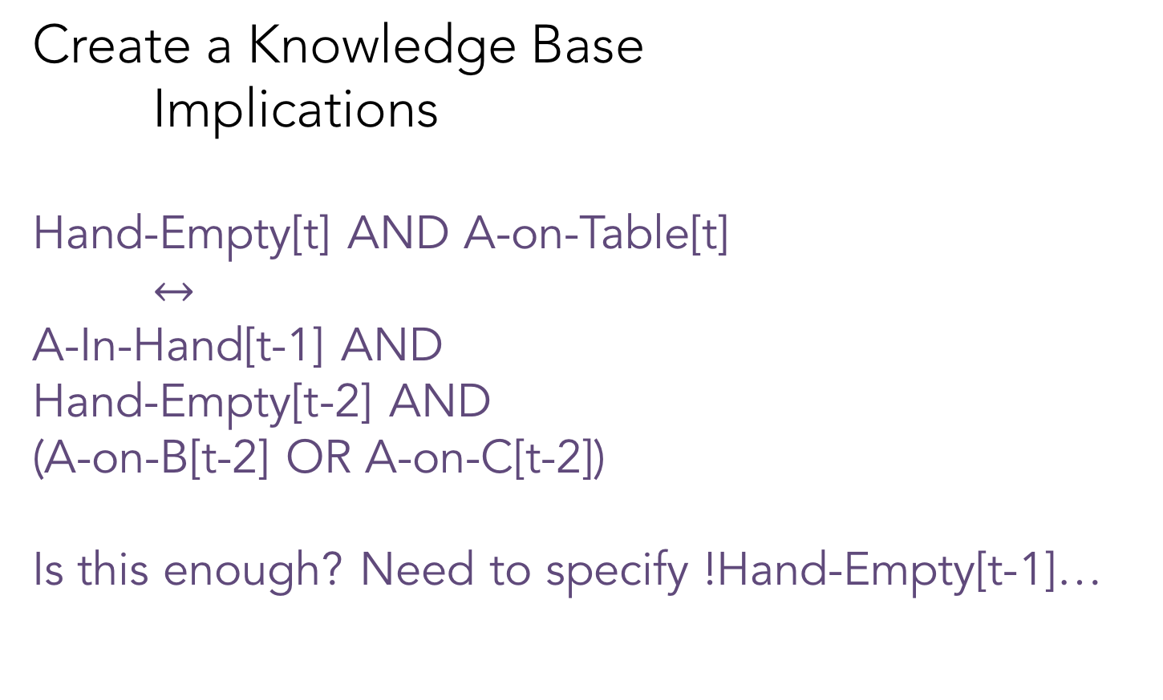
Logical Agents
Create a Knowledge Base
Implications
Hand-Empty[t] AND A-on-Table[t]
$↔$
A-In-Hand[t-1] AND
Hand-Empty[t-2] AND
(A-on-B[t-2] OR A-on-C[t-2])
Is this enough? Need to specify !Hand-Empty[t-1]…
Robot Arm
A
B
C

Slide 32
Logical Agents
Create a Knowledge Base
Symbols
Implications
Check whether the KB entails a query
Query – a subset of symbols in model

Slide 33
Logical Agents
Create a Knowledge Base
Symbols
Implications
Check whether the KB entails a query
Query – a subset of symbols in model
B-on-C[t] AND C-on-A[t] AND HandEmpty[t]?

Slide 34
Partially-Specified
We didn’t tell you what all goal symbols needed to be, only some
There are potentially many goal states that could satisfy this goal
We only need to search for one satisfying assignment of variables

Slide 35
Challenges of Logic Planning
We need symbols for each time step
The actions (e.g., picking a block) are implicitly represented as the implications
Easy to incorrectly specify an implication
So many symbols means it is hard to debug

Slide 36
Classical Planning
Also partially-specified
Create a Knowledge Base
Symbols Predicates
Implications Operators
Check whether the KB entails a query
A goal state (conjunction of predicates)

Slide 37
Predicates
Can be symbols
A-on-Table, A-In-Hand,
B-on-Table, B-In-Hand,
C-on-Table, C-In-Hand,
Hand-Empty,
A-on-B, B-on-A,
A-on-C, C-on-A,
B-on-C, C-on-B
Clear-A, Clear-B,
Clear-C

Slide 38
Predicates
Can be symbols
A-on-Table, A-In-Hand,
B-on-Table, B-In-Hand,
C-on-Table, C-In-Hand,
Hand-Empty,
A-on-B, B-on-A,
A-on-C, C-on-A,
B-on-C, C-on-B
Clear-A, Clear-B,
Clear-C
Can be functional
Instances: A, B, C
Propositions:
In-Hand(A)
On-Table(B)
On-Block(B,C)
HandEmpty()
Clear(A)

Slide 39
Predicates
Are there other functions that we could use?

Slide 40
Predicates
Are there other functions that we could use?
YES!!
Your challenge is finding a representation that works for your environment

Slide 41
Piazza Poll – Check all that apply
Instances: A, B, C
Propositions:
1) In-Hand(A)
2) In-Hand(B)
3) In-Hand(C)
4) On-Table(A)
5) On-Table(B)
6) On-Table(C)
7) On-Block(B,C)
8) On-Block(A,B)
9) HandEmpty()
Robot Arm
A
B
C

Slide 42
Piazza Poll – Check all that apply
Instances: A, B, C
Propositions:
1) In-Hand(A)
2) In-Hand(B)
3) In-Hand(C)
4) On-Table(A)
5) On-Table(B)
6) On-Table(C)
7) On-Block(B,C)
8) On-Block(A,B)
9) HandEmpty()
A
C
B

Slide 43
Classical Planning
Also partially-specified
Create a Knowledge Base
Symbols Predicates
Implications Operators
Check whether the KB entails a query
A goal state (conjunction of predicates)

Slide 44
Models of Operators (Actions)
Actions can be applied only if all conditions are met
Actions change the state of the world
Represented as effects that add/delete predicates
Unlike the implications, we can represent actions with symbolic descriptions (e.g., pick-up, put-down)

Slide 45
Block Stacking States – Conjunctions of Predicates

Slide 46
Block Stacking Operators (Actions)

Slide 47
What actions are represented? What are the rules for applying actions?

Slide 48
Actions for Block Stacking
Blocks are picked up and put down by the hand
Blocks can be picked up only if they are clear
Hand can pick up a block only if the hand is empty
Hand can put down blocks on blocks or on the table

Slide 49
Pick Up Block from Table Example
Preconditions

Slide 50
Pick Up Block from Table Example
Preconditions
HandEmpty
On-Table(b)
Clear(b)

Slide 51
Pick Up Block from Table Example
Preconditions Effects?
HandEmpty
On-Table(b)
Clear(b)

Slide 52
Pick Up Block from Table Example
Preconditions Effects
HandEmpty Add: Holding(b)
On-Table(b) Delete: On-Table(b)
Clear(b) HandEmpty

Slide 53
Pick Block from Block Example
Preconditions Effects

Slide 54
Operators for Block Stacking
Pickup_from_Table(b):
Pre: HandEmpty, Clear(b), On-Table(b)
Add: Holding(b)
Delete: HandEmpty, On-Table(b)
Pickup_from_Block(b,c):
Pre: HandEmpty, On(b,c), b!=c
Add: Holding(b), Clear(c)
Delete: HandEmpty, On(b,c)

Slide 55
Operators for Block Stacking
Pickup_from_Table(b):
Pre: HandEmpty, Clear(b), On-Table(b)
Add: Holding(b)
Delete: HandEmpty, On-Table(b)
Putdown_on_Table(b):
Pre: Holding(b)
Add: HandEmpty, On-Table(b)
Delete: Holding(b)
Pickup_from_Block(b,c):
Pre: HandEmpty, On(b,c), b!=c
Add: Holding(b), Clear(c)
Delete: HandEmpty, On(b,c)
Putdown_on_Block(b,c):
Pre: Holding(b), Clear(c)
Add: HandEmpty, On(b,c)
Delete: Clear(c), Holding(b)

Slide 56
Example Plan of Actions
HandEmpty & On-Table(R) & On(T,R) & Clear(T) & On-Table(O) & Clear(O)

Slide 57
Example Plan of Actions
HandEmpty & On-Table(R) & On(T,R) & Clear(T) & On-Table(O) & Clear(O)
Pickup_from_Block(b,c):
Pre: HandEmpty, On(b,c), b!=c
Add: Holding(b), Clear(c)
Delete: HandEmpty, On(b,c)
Pickup_from_Table(b):
Pre: HandEmpty, Clear(b), On-Table(b)
Add: Holding(b)
Delete: HandEmpty, On-Table(b)

Slide 58
Example Plan of Actions
HandEmpty & On-Table(R) & On(T,R) & Clear(T) & On-Table(O) & Clear(O)
Pickup_from_Block(b,c):
Pre: HandEmpty, On(b,c), b!=c
Add: Holding(b), Clear(c)
Delete: HandEmpty, On(b,c)
Pickup_from_Table(b):
Pre: HandEmpty, Clear(b), On-Table(b)
Add: Holding(b)
Delete: HandEmpty, On-Table(b)

Slide 59
Example Plan of Actions
HandEmpty & On-Table(R) & On(T,R) & Clear(T) & On-Table(O) & Clear(O)
Pickup_from_Block(T,R)
Pickup_from_Block(b,c):
Pre: HandEmpty, On(b,c), Clear(c), b!=c
Add: Holding(b), Clear(c)
Delete: HandEmpty, On(b,c)

Slide 60
Example Plan of Actions
HandEmpty & On-Table(R) & On(T,R) & Clear(T) & On-Table(O) & Clear(O)
Pickup_from_Block(T,R)
On-Table(R) & Clear(T) & On-Table(O) & Clear(O)
Pickup_from_Block(b,c):
Pre: HandEmpty, On(b,c), Clear(c), b!=c
Add: Holding(b), Clear(c)
Delete: HandEmpty, On(b,c)

Slide 61
Example Plan of Actions
HandEmpty & On-Table(R) & On(T,R) & Clear(T) & On-Table(O) & Clear(O)
Pickup_from_Block(T,R)
On-Table(R) & Clear(T) & On-Table(O) & Clear(O) & Holding(T) & Clear(R)
Pickup_from_Block(b,c):
Pre: HandEmpty, On(b,c), Clear(c), b!=c
Add: Holding(b), Clear(c)
Delete: HandEmpty, On(b,c)

Slide 62
Example Plan of Actions
HandEmpty & On-Table(R) & On(T,R) & Clear(T) & On-Table(O) & Clear(O)
Pickup_from_Block(T,R)
On-Table(R) & Clear(T) & On-Table(O) & Clear(O) & Holding(T) & Clear(R)

Slide 63
Example Plan of Actions
HandEmpty & On-Table(R) & On(T,R) & Clear(T) & On-Table(O) & Clear(O)
Pickup_from_Block(T,R)
On-Table(R) & Clear(T) & On-Table(O) & Clear(O) & Holding(T) & Clear(R)
Putdown_on_Table(T)
Putdown_on_Table(b):
Pre: Holding(b)
Add: HandEmpty, On-Table(b)
Delete: Holding(b)

Slide 64
Example Plan of Actions
HandEmpty & On-Table(R) & On(T,R) & Clear(T) & On-Table(O) & Clear(O)
Pickup_from_Block(T,R)
On-Table(R) & Clear(T) & On-Table(O) & Clear(O) & Holding(T) & Clear(R)
Putdown_on_Table(T)
On-Table(R) & Clear(T) & On-Table(O) & Clear(O) & Clear(R)
Putdown_on_Table(b):
Pre: Holding(b)
Add: HandEmpty, On-Table(b)
Delete: Holding(b)

Slide 65
Example Plan of Actions
HandEmpty & On-Table(R) & On(T,R) & Clear(T) & On-Table(O) & Clear(O)
Pickup_from_Block(T,R)
On-Table(R) & Clear(T) & On-Table(O) & Clear(O) & Holding(T) & Clear(R)
Putdown_on_Table(T)
On-Table(R) & Clear(T) & On-Table(O) & Clear(O) & Clear(R) & HandEmpty & On-Table(T)
Putdown_on_Table(b):
Pre: Holding(b)
Add: HandEmpty, On-Table(b)
Delete: Holding(b)

Slide 66
Example Plan of Actions
HandEmpty & On-Table(R) & On(T,R) & Clear(T) & On-Table(O) & Clear(O)
Pickup_from_Block(T,R)
On-Table(R) & Clear(T) & On-Table(O) & Clear(O) & Holding(T) & Clear(R)
Putdown_on_Table(T)
On-Table(R) & Clear(T) & On-Table(O) & Clear(O) & Clear(R) & HandEmpty & On-Table(T)

Slide 67
Example Plan of Actions
HandEmpty & On-Table(R) & On(T,R) & Clear(T) & On-Table(O) & Clear(O)
Pickup_from_Block(T,R)
On-Table(R) & Clear(T) & On-Table(O) & Clear(O) & Holding(T) & Clear(R)
Putdown_on_Table(T)
On-Table(R) & Clear(T) & On-Table(O) & Clear(O) & Clear(R) & HandEmpty & On-Table(T)
Pickup_from_Table(O)
Pickup_from_Table(b):
Pre: HandEmpty, Clear(b), On-Table(b)
Add: Holding(b)
Delete: HandEmpty, On-Table(b)

Slide 68
Example Plan of Actions
HandEmpty & On-Table(R) & On(T,R) & Clear(T) & On-Table(O) & Clear(O)
Pickup_from_Block(T,R)
On-Table(R) & Clear(T) & On-Table(O) & Clear(O) & Holding(T) & Clear(R)
Putdown_on_Table(T)
On-Table(R) & Clear(T) & On-Table(O) & Clear(O) & Clear(R) & HandEmpty & On-Table(T)
Pickup_from_Table(O)
On-Table(R) & Clear(T) & Clear(O) & Clear(R) & On-Table(T) & Holding(O)
Pickup_from_Table(b):
Pre: HandEmpty, Clear(b), On-Table(b)
Add: Holding(b)
Delete: HandEmpty, On-Table(b)

Slide 69
Example Plan of Actions
HandEmpty & On-Table(R) & On(T,R) & Clear(T) & On-Table(O) & Clear(O)
Pickup_from_Block(T,R)
On-Table(R) & Clear(T) & On-Table(O) & Clear(O) & Holding(T) & Clear(R)
Putdown_on_Table(T)
On-Table(R) & Clear(T) & On-Table(O) & Clear(O) & Clear(R) & HandEmpty & On-Table(T)
Pickup_from_Table(O)
On-Table(R) & Clear(T) & Clear(O) & Clear(R) & On-Table(T) & Holding(O)
Putdown_on_Block(O,R)
On-Table(R) & Clear(T) & Clear(O) & On-Table(T) & On(O,R) & HandEmpty

Slide 70
Properties of Planners
Soundness
A planning algorithm is sound if all solutions found are legal plans
All preconditions and goals are satisfied
No constraints are violated (temporal, variable binding)
Completeness
A planning algorithm is complete if a solution can be found whenever one actually exists
A planning algorithm is strictly complete if all solutions are included in the search space
Optimality
A planning algorithm is optimal if the order in which solutions are found is consistent with some measure of plan quality

Slide 71
Techniques for Planning
Start
Goal

Slide 72
BFS – Find shortest action sequence
Start
Goal

Slide 73
Reachability Graph Representation
States: Conjunctions of Predicates
Arrows = Actions
Every state in level K is reachable in K actions
Space complexity in terms of # predicates p?

Slide 74
Reachability Graph Representation
States: Conjunctions of Predicates
Arrows = Actions
Every state in level K is reachable in K actions
Space complexity in terms of # predicates? 2^{p}

Slide 75
Poll: Is BFS sound, complete, optimal?
Start
Goal
Soundness - all solutions found are legal plans
Completeness - a solution can be found whenever one actually exists
Optimality - the order in which solutions are found is consistent with some measure of plan quality

Slide 76
Linear Planning
Idea: Since we have a conjunction of goal predicates, let’s try to solve one at a time
Maintain a stack of achievable goals
Use BFS (or anything else) to find a plan to achieve that single goal
Add a goal back on the stack if a later change makes it violated

Slide 77
Linear Planning Example
Goal Stack:
On-Table(T)
On-Table(R)
On(O,R)
Clear(O)
Clear(T)
Action Plan:

Slide 78
Linear Planning Example
Goal Stack:
On-Table(T)
On-Table(R)
On(O,R)
Clear(O)
Clear(T)
Action Plan:

Slide 79
Linear Planning Example
Goal Stack:
On-Table(R)
On(O,R)
Clear(O)
Clear(T)
Action Plan:
On-Table(T)
Pickup(T)
Put-Table(T)

Slide 80
Linear Planning Example
Goal Stack:
On-Table(R)
On(O,R)
Clear(O)
Clear(T)
Action Plan:
On-Table(T)
Pickup(T)
Put-Table(T)

Slide 81
Linear Planning Example
Goal Stack:
On(O,R)
Clear(O)
Clear(T)
Action Plan:
On-Table(T)
Pickup(T)
Put-Table(T)
On-Table(R)

Slide 82
Linear Planning Example
Goal Stack:
On(O,R)
Clear(O)
Clear(T)
Action Plan:
On-Table(T)
Pickup(T)
Put-Table(T)
On-Table(R)

Slide 83
Linear Planning Example
Goal Stack:
Clear(O)
Clear(T)
Action Plan:
On-Table(T)
Pickup(T)
Put-Table(T)
On-Table(R)
On(O,R)
Pickup(O)
Put(O,R)

Slide 84
Linear Planning Example
Goal Stack:
Clear(O)
Clear(T)
Action Plan:
On-Table(T)
Pickup(T)
Put-Table(T)
On-Table(R)
On(O,R)
Pickup(O)
Put(O,R)

Slide 85
Linear Planning Example
Goal Stack:
Action Plan:
On-Table(T)
Pickup(T)
Put-Table(T)
On-Table(R)
On(O,R)
Pickup(O)
Put(O,R)
Clear(O)
Clear(T)

Slide 86
Linear Planning Example 2
Goal Stack:
On(R,O)
On-Table(T)
On(O,T)
Clear(R)
Action Plan:

Slide 87
Linear Planning Example 2
Goal Stack:
On(R,O)
On-Table(T)
On(O,T)
Clear(R)
Action Plan:

Slide 88
Linear Planning Example 2
Goal Stack:
On-Table(T)
On(O,T)
Clear(R)
Action Plan:
On(R,O)
Pickup(T)
Put-Table(T)
Pickup(R)
Put(R,O)

Slide 89
Linear Planning Example 2
Goal Stack:
On-Table(T)
On(O,T)
Clear(R)
Action Plan:
On(R,O)
Pickup(T)
Put-Table(T)
Pickup(R)
Put(R,O)

Slide 90
Linear Planning Example 2
Goal Stack:
On(O,T)
Clear(R)
Action Plan:
On(R,O)
Pickup(T)
Put-Table(T)
Pickup(R)
Put(R,O)
On-Table(T)

Slide 91
Linear Planning Example 2
Goal Stack:
On(O,T)
Clear(R)
Action Plan:
On(R,O)
Pickup(T)
Put-Table(T)
Pickup(R)
Put(R,O)
On-Table(T)

Slide 92
Linear Planning Example 2
Goal Stack:
Clear(R)
Action Plan:
On(R,O)
Pickup(T)
Put-Table(T)
Pickup(R)
Put(R,O)
On-Table(T)
On(O,T)
Pickup(R)
Put-Table(R)
Pickup(O)
Put(O,T)

Slide 93
Linear Planning Example 2
Goal Stack:
On(R,O)
Clear(R)
Action Plan:
On(R,O)
Pickup(T)
Put-Table(T)
Pickup(R)
Put(R,O)
On-Table(T)
On(O,T)
Pickup(R)
Put-Table(R)
Pickup(O)
Put(O,T)

Slide 94
Linear Planning Example 2
Goal Stack:
Clear(R)
Action Plan:
On(R,O)
Pickup(T)
Put-Table(T)
Pickup(R)
Put(R,O)
On-Table(T)
On(O,T)
Pickup(R)
Put-Table(R)
Pickup(O)
Put(O,T)
Action Plan (cont’d):
On(R,O)
Pickup(R)
Put(R,O)

Slide 95
Linear Planning Example 2
Goal Stack:
Action Plan:
On(R,O)
Pickup(T)
Put-Table(T)
Pickup(R)
Put(R,O)
On-Table(T)
On(O,T)
Pickup(R)
Put-Table(R)
Pickup(O)
Put(O,T)
Action Plan (cont’d):
On(R,O)
Pickup(R)
Put(R,O)
Clear(R)

Slide 96
Linear Planning Example 2
Goal Stack:
Action Plan:
On(R,O)
Pickup(T)
Put-Table(T)
Pickup(R)
Put(R,O)
On-Table(T)
On(O,T)
Pickup(R)
Put-Table(R)
Pickup(O)
Put(O,T)
Action Plan (cont’d):
On(R,O)
Pickup(R)
Put(R,O)
Clear(R)
What happened?
Is linear planning sound?
Is linear planning complete?
Is linear planning optimal?

Slide 97
Sussman’s Anomaly
A weakness of linear planning is that sometimes you get really long plans
One goal can be achieved
The second goal immediately undoes it
Note: This isn’t just a choice of goals. The anomaly happens no matter which goal is first

Slide 98
Linear Planning Example 2
Goal Stack:
Action Plan:
On(R,O)
Pickup(T)
Put-Table(T)
Pickup(R)
Put(R,O)
On-Table(T)
On(O,T)
Pickup(R)
Put-Table(R)
Pickup(O)
Put(O,T)
Action Plan (cont’d):
On(R,O)
Pickup(R)
Put(R,O)
Clear(R)
What happened?
Is linear planning sound? Yes
Is linear planning complete? No
Is linear planning optimal? No

Slide 99
Non-Linear Planning
Idea: Interleave goals to achieve plans
Maintain a set of unachieved goals
Search all interleavings of goals
Add a goal back to the set if a later change makes it violated

Slide 100
Non-Linear Planning (Example 2)
Goal Set:
On(R,O)
On-Table(T)
On(O,T)
Clear(R)
Action Plan:

Slide 101
Non-Linear Planning (Example 2)
Goal Set:
On(R,O)
On-Table(T)
On(O,T)
Clear(R)
Action Plan:
On(R,O)
Pickup(T)
Put-Table(T)
STOP-SWITCH-GOALS

Slide 102
Non-Linear Planning (Example 2)
Goal Set:
On(R,O)
On-Table(T)
On(O,T)
Clear(R)
Action Plan:
On(R,O)
Pickup(T)
Put-Table(T)
STOP-SWITCH-GOALS
On(O,T)
Pickup(O)
Put(O,T)

Slide 103
Non-Linear Planning (Example 2)
Goal Set:
On(R,O)
On-Table(T)
On(O,T)
Clear(R)
Action Plan:
On(R,O)
Pickup(T)
Put-Table(T)
STOP-SWITCH-GOALS
On(O,T)
Pickup(O)
Put(O,T)
On(R,O)
Pickup(R)
Put(R,O)

Slide 104
Non-Linear Planning (Example 2)
Goal Set:
On(R,O)
On-Table(T)
On(O,T)
Clear(R)
Action Plan:
On(R,O)
Pickup(T)
Put-Table(T)
STOP-SWITCH-GOALS
On(O,T)
Pickup(O)
Put(O,T)
On(R,O)
Pickup(R)
Put(R,O)
6 vs 10 actions

Slide 105
Non-Linear Planning
Idea: Interleave goals to achieve plans
Maintain a set of unachieved goals
Search all interleavings of goals
Add a goal back to the set if a later change makes it violated
It is complete, but takes longer to search
It can produce shorter plans
Optimal plans if all interleavings are searched

Slide 106
Reachability Graph Representation
States: Conjunctions of Predicates
Arrows = Actions
Every state in level K is reachable in K actions
Space complexity in terms of # predicates p?

Slide 107
Planning Graph Representation
Key idea: Construct an approximation of the reachability graph in polynomial space
The planning graph computes the possibly reachable states although they aren’t necessarily feasible

Slide 108
Planning Graph Representation
Key idea: Construct an approximation of the reachability graph in polynomial space
The planning graph computes the possibly reachable states although they aren’t necessarily feasible
Planning graphs contain two types of layers
Proposition layers – all reachable predicates
Action layers – actions that could be taken
Both layers represent one time step

Slide 109
GraphPlan
Two alternating stages:
Extend: One time step (two layers) in the planning graph
Search: Find a valid plan in the planning graph
GraphPlan finds a plan or proves that no plan has fewer time steps
Each time step can contain multiple actions

Slide 110
Building a Planning Graph
Start the planning graph with all starting predicates
HandEmpty
On-Table(R)
On-Table(O)
On(T,R)
Clear(T)
Clear(O)

Slide 111
Building a Planning Graph
Extend the graph with all applicable actions
Designate all effects (add/delete)
HandEmpty
On-Table(R)
On-Table(O)
On(T,R)
Clear(T)
Clear(O)
HandEmpty
On-Table(R)
On-Table(O)
On(T,R)
Clear(T)
Clear(O)
Clear(R)
Holding(T)
Holding(O)
Pickup(T)
Pickup(O)

Slide 112
Building a Planning Graph
Extend the graph with all applicable actions, noops
Designate all effects (add/delete)
HandEmpty
On-Table(R)
On-Table(O)
On(T,R)
Clear(T)
Clear(O)
HandEmpty
On-Table(R)
On-Table(O)
On(T,R)
Clear(T)
Clear(O)
Clear(R)
Holding(T)
Holding(O)
Pickup(T)
Pickup(O)

Slide 113
Building a Planning Graph
Extend the graph
Determine exclusive actions
HandEmpty
On-Table(R)
On-Table(O)
On(T,R)
Clear(T)
Clear(O)
HandEmpty
On-Table(R)
On-Table(O)
On(T,R)
Clear(T)
Clear(O)
Clear(R)
Holding(T)
Holding(O)
Actions A and B are exclusive (mutex) at action-level i, if:
Interference: one action deletes a precondition of the other
Inconsistency: one action is the negation of the other
Competing Needs: p is a precondition of A and q is a precondition of B, and p and q are exclusive in proposition-level i – 1
Pickup(T)
Pickup(O)

Slide 114
Building a Planning Graph
Extend the graph with all applicable actions, noops
Determine exclusive actions
HandEmpty
On-Table(R)
On-Table(O)
On(T,R)
Clear(T)
Clear(O)
HandEmpty
On-Table(R)
On-Table(O)
On(T,R)
Clear(T)
Clear(O)
Clear(R)
Holding(T)
Holding(O)
Actions A and B are exclusive (mutex) at action-level i, if:
Interference: one action deletes a precondition of the other
Inconsistency: one action is the negation of the other
Competing Needs: p is a precondition of A and q is a precondition of B, and p and q are exclusive in proposition-level i – 1
Pickup(T)
Pickup(O)

Slide 115
Building a Planning Graph
Extend the graph with all applicable actions, noops
Determine exclusive actions
HandEmpty
On-Table(R)
On-Table(O)
On(T,R)
Clear(T)
Clear(O)
HandEmpty
On-Table(R)
On-Table(O)
On(T,R)
Clear(T)
Clear(O)
Clear(R)
Holding(T)
Holding(O)
Actions A and B are exclusive (mutex) at action-level i, if:
Interference: one action deletes a precondition of the other
Inconsistency: one action is the negation of the other
Competing Needs: p is a precondition of A and q is a precondition of B, and p and q are exclusive in proposition-level i – 1
Pickup(T)
Pickup(O)

Slide 116
Building a Planning Graph
Extend the graph with all applicable actions, noops
Determine exclusive actions, propositions
HandEmpty
On-Table(R)
On-Table(O)
On(T,R)
Clear(T)
Clear(O)
HandEmpty
On-Table(R)
On-Table(O)
On(T,R)
Clear(T)
Clear(O)
Clear(R)
Holding(T)
Holding(O)
Two propositions p and q are exclusive (mutex) at a proposition-level if ALL actions (including no-ops) that add p are exclusive of ALL actions that add q
Pickup(T)
Pickup(O)

Slide 117
Search the Planning Graph
Extend until first time all goals are present at a proposition level
May not be a solution, at that level
For each goal at level i (in some arbitrary order)
Select an action at level i-1 that achieves that goal and is not exclusive with any other action already selected at that level
Add all its preconditions to the set of goals at level i-2
Do this for all the goals at level i
Use already selected actions, when possible
Backtrack if no non-exclusive action exists
If search is exhausted, extend planning graph one more proposition level

Slide 118
Extend a Level
Extend the graph with all applicable actions, noops
Determine exclusive actions, propositions
HandEmpty
On-Table(R)
On-Table(O)
On(T,R)
Clear(T)
Clear(O)
HandEmpty
On-Table(R)
On-Table(O)
On(T,R)
Clear(T)
Clear(O)
Clear(R)
Holding(T)
Holding(O)
Pickup(T)
Pickup(O)

Slide 119
Building a Planning Graph
Extend the graph with all applicable actions, noops
Determine exclusive actions, propositions
HandEmpty
On-Table(R)
On-Table(O)
On(T,R)
Clear(T)
Clear(O)
HandEmpty
On-Table(R)
On-Table(O)
On(T,R)
Clear(T)
Clear(O)
Clear(R)
Holding(T)
Holding(O)
HandEmpty
On-Table(R)
On-Table(T)
On-Table(O)
On(O,T)
On(T,R)
On(T,O)
Clear(T)
Clear(O)
Clear(R)
Holding(T)
Holding(O)
Pickup(T)
Pickup(T)
Put(T,R)
Put(T,O)
Pickup(O)
Put-Table(T)
Pickup(O)
Put-Table(O)
Put(O,T)
Pickup(R)

Slide 120
Building a Planning Graph
Extend the graph with all applicable actions, noops
Determine exclusive actions, propositions
HandEmpty
On-Table(R)
On-Table(O)
On(T,R)
Clear(T)
Clear(O)
HandEmpty
On-Table(R)
On-Table(O)
On(T,R)
Clear(T)
Clear(O)
Clear(R)
Holding(T)
Holding(O)
HandEmpty
On-Table(R)
On-Table(T)
On-Table(O)
On(O,T)
On(T,R)
On(T,O)
Clear(T)
Clear(O)
Clear(R)
Holding(T)
Holding(O)
Pickup(T)
Pickup(T)
Put(T,R)
Put(T,O)
Pickup(O)
Put-Table(T)
Pickup(O)
Put-Table(O)
Put(O,T)
Pickup(R)

Slide 121
Building a Planning Graph
Extend the graph with all applicable actions, noops
Determine exclusive actions, propositions
HandEmpty
On-Table(R)
On-Table(O)
On(T,R)
Clear(T)
Clear(O)
HandEmpty
On-Table(R)
On-Table(O)
On(T,R)
Clear(T)
Clear(O)
Clear(R)
Holding(T)
Holding(O)
HandEmpty
On-Table(R)
On-Table(T)
On-Table(O)
On(O,T)
On(T,R)
On(T,O)
Clear(T)
Clear(O)
Clear(R)
Holding(T)
Holding(O)
Pickup(T)
Pickup(T)
Put(T,R)
Put(T,O)
Pickup(O)
Put-Table(T)
Pickup(O)
Put-Table(O)
ALL LEVEL 2 ACTIONS
MUTALLY EXCLUSIVE…
WHAT KIND?
Put(O,T)
Pickup(R)

Slide 122
Building a Planning Graph
Extend the graph with all applicable actions, noops
Determine exclusive actions, propositions
HandEmpty
On-Table(R)
On-Table(O)
On(T,R)
Clear(T)
Clear(O)
HandEmpty
On-Table(R)
On-Table(O)
On(T,R)
Clear(T)
Clear(O)
Clear(R)
Holding(T)
Holding(O)
HandEmpty
On-Table(R)
On-Table(T)
On-Table(O)
On(O,T)
On(T,R)
On(T,O)
Clear(T)
Clear(O)
Clear(R)
Holding(T)
Holding(O)
Pickup(T)
Pickup(T)
Put(T,R)
Put(T,O)
Pickup(O)
Put-Table(T)
Pickup(O)
Put-Table(O)
PICK and PUT are Inconsistent
Pick requires HandEmpty
Put requires !HandEmpty
Put(O,T)
Pickup(R)

Slide 123
Building a Planning Graph
Extend the graph with all applicable actions, noops
Determine exclusive actions, propositions
HandEmpty
On-Table(R)
On-Table(O)
On(T,R)
Clear(T)
Clear(O)
HandEmpty
On-Table(R)
On-Table(O)
On(T,R)
Clear(T)
Clear(O)
Clear(R)
Holding(T)
Holding(O)
HandEmpty
On-Table(R)
On-Table(T)
On-Table(O)
On(O,T)
On(T,R)
On(T,O)
Clear(T)
Clear(O)
Clear(R)
Holding(T)
Holding(O)
Pickup(T)
Pickup(T)
Put(T,R)
Put(T,O)
Pickup(O)
Put-Table(T)
Pickup(O)
Put-Table(O)
2 PICK actions are Interference
A pick requires HandEmpty
but the other deletes it
Put(O,T)
Pickup(R)

Slide 124
Planning Graph Heuristics
Key idea: Construct an approximation of the reachability graph in polynomial space
The planning graph computes the possibly reachable states although they aren’t necessarily feasible
What kinds of heuristics could we apply to the planning graph?
Is the solution GraphPlan finds admissible?

Slide 125
How can we program GraphPlan?

Slide 126
How can we program GraphPlan?
Literals: Each thing in our model
i = Instance(“name”,TYPE)
Variables: Can take on any TYPE thing
v_a = Variable(“v_name”,TYPE)
Propositions: Relationships
Proposition(“relation”, v_a)
Proposition(“relation”, i)
Proposition(“relation2”, v, i)
Proposition(“relation2”, v_a, v_b)

Slide 127
Example
A = Instance(“blockA”, BLOCK)
B = Instance(“blockB”, BLOCK)
C = Instance(“blockC”, BLOCK)
Proposition(”on”, B, A)
Proposition(”on-table”, A)
Proposition(”on-table”, C)
Proposition(”clear”, B)
Proposition(”clear”, C)
Proposition(“handempty”, True)

Slide 128
Piazza Poll – Select All
A = Instance(“blockA”, BLOCK)
B = Instance(“blockB”, BLOCK)
C = Instance(“blockC”, BLOCK)
a. Proposition(”on”, B, A)
b. Proposition(“on”, B, C)
c. Proposition(”on-table”, A)
d. Proposition(”on-table”, C)
e. Proposition(”clear”, B)
f. Proposition(”clear”, C)

Slide 129
How can we program operators?
Operators: the actions we take change state
o = Operator(“name”,
[], #preconditions
[], #add effects
[]) # delete effects

Slide 130
How can we program operators?
Operators: the actions we take change state
pickup_table = Operator(“pick_table”,
[Proposition(“Handempty”,True),
Proposition(“clear”, v_block),
Proposition(“on-table”, v_block)],
[Proposition(“holding”, v_block)], [Proposition(“Handempty”,True),
Proposition(“on-table”, v_block]
)

Slide 131
How can we program operators?
Operators: the actions we take change state
pickup_table = Operator(“pick_table”,
[Proposition(“Handempty”,True),
Proposition(“clear”, v_block),
Proposition(“on-table”, v_block)],
[Proposition(“holding”, v_block)], [Proposition(“Handempty”,True),
Proposition(“on-table”, v_block]
)
Lists are conjunctions
Lists are conjunctions
Lists are conjunctions

Slide 132
How can we program operators?
Operators: the actions we take change state
pickup_table = Operator(“pick_table”,
[Proposition(“Handempty”,True),
Proposition(“clear”, v_block),
Proposition(“on-table”, v_block)],
[Proposition(“holding”, v_block)], [Proposition(“Handempty”,True),
Proposition(“on-table”, v_block]
)
Variable with matching name must match subsequent propositions

Slide 133
How can we program operators?
Operators: the actions we take change state
pickup_table = Operator(“pick_table”,
[Proposition(“Handempty”,True),
Proposition(“clear”, v_block),
Proposition(“on-table”, v_block2)],
[Proposition(“holding”, v_block)], [Proposition(“Handempty”,True),
Proposition(“on-table”, v_block]
)
Variable with matching name must match subsequent propositions
Variables that don’t match name don’t have to be the same

Slide 134
We will give you a GraphPlan Solver
Solver takes all instances, all operators, the start state and the goal state and produces a plan

Slide 135
Another Example - Rocket Ship
Suppose we have a rocket ship that can only be used once. It has to carry two payloads.

Slide 136
Another Example - Rocket Ship
Suppose we have a rocket ship that can only be used once. It has to carry two payloads.
Literals?

Slide 137
Another Example - Rocket Ship
Suppose we have a rocket ship that can only be used once. It has to carry two payloads.
Literals: Rocket, G, O, LocA, LocB

Slide 138
Another Example - Rocket Ship
Suppose we have a rocket ship that can only be used once. It has to carry two payloads.
Literals: Rocket, G, O, LocA, LocB
Start state:
At(Rocket, LocA), Has-Fuel(),
Unloaded(G,LocA), Unloaded(O,LocA)

Slide 139
Another Example - Rocket Ship
Suppose we have a rocket ship that can only be used once. It has to carry two payloads.
Literals: Rocket, G, O, LocA, LocB
Start state:
At(Rocket, LocA), Has-Fuel(),
Unloaded(G,LocA), Unloaded(O,LocA)
Goal state:
At(Rocket, LocB), Unloaded(G,LocB), Unloaded(O,LocB)

Slide 140
Another Example - Rocket Ship
Literals: Rocket, G, O, LocA, LocB
Start state:
At(Rocket, LocA), Has-Fuel(),
Unloaded(G,LocA), Unloaded(O,LocA)
Goal state:
At(Rocket, LocB), Unloaded(G,LocB), Unloaded(O,LocB)
Move: Load: Unload:

Slide 141
Another Example - Rocket Ship
Literals: Rocket, G, O, LocA, LocB
Start state:
At(Rocket, LocA), Has-Fuel(),
Unloaded(G,LocA), Unloaded(O,LocA)
Goal state:
At(Rocket, LocB), Unloaded(G,LocB), Unloaded(O,LocB)
Move:
P:
A:
D:

Slide 142
Another Example - Rocket Ship
Literals: Rocket, G, O, LocA, LocB
Start state:
At(Rocket, LocA), Has-Fuel(),
Unloaded(G,LocA), Unloaded(O,LocA)
Goal state:
At(Rocket, LocB), Unloaded(G,LocB), Unloaded(O,LocB)
Move:
P: At(Rocket,L)
A:
D:

Slide 143
Another Example - Rocket Ship
Literals: Rocket, G, O, LocA, LocB
Start state:
At(Rocket, LocA), Has-Fuel(),
Unloaded(G,LocA), Unloaded(O,LocA)
Goal state:
At(Rocket, LocB), Unloaded(G,LocB), Unloaded(O,LocB)
Move:
P: At(Rocket,L)
A:
D:

Slide 144
Another Example - Rocket Ship
Literals: Rocket, G, O, LocA, LocB
Start state:
At(Rocket, LocA), Has-Fuel(),
Unloaded(G,LocA), Unloaded(O,LocA)
Goal state:
At(Rocket, LocB), Unloaded(G,LocB), Unloaded(O,LocB)
Variables: L
Move:
P: At(Rocket,L)
A:
D:

Slide 145
Another Example - Rocket Ship
Literals: Rocket, G, O, LocA, LocB
Start state:
At(Rocket, LocA), Has-Fuel(),
Unloaded(G,LocA), Unloaded(O,LocA)
Goal state:
At(Rocket, LocB), Unloaded(G,LocB), Unloaded(O,LocB)
Variables: L
Move:
P: At(Rocket,L), Has-Fuel()
A:
D:

Slide 146
Another Example - Rocket Ship
Literals: Rocket, G, O, LocA, LocB
Start state:
At(Rocket, LocA), Has-Fuel(),
Unloaded(G,LocA), Unloaded(O,LocA)
Goal state:
At(Rocket, LocB), Unloaded(G,LocB), Unloaded(O,LocB)
Variables: L
Move:
P: At(Rocket,L), Has-Fuel()
A: At(Rocket,Dest)
D:

Slide 147
Another Example - Rocket Ship
Literals: Rocket, G, O, LocA, LocB
Start state:
At(Rocket, LocA), Has-Fuel(),
Unloaded(G,LocA), Unloaded(O,LocA)
Goal state:
At(Rocket, LocB), Unloaded(G,LocB), Unloaded(O,LocB)
Variables: L, Dest
Move:
P: At(Rocket,L), Has-Fuel()
A: At(Rocket,Dest)
D:

Slide 148
Another Example - Rocket Ship
Literals: Rocket, G, O, LocA, LocB
Start state:
At(Rocket, LocA), Has-Fuel(),
Unloaded(G,LocA), Unloaded(O,LocA)
Goal state:
At(Rocket, LocB), Unloaded(G,LocB), Unloaded(O,LocB)
Variables: L, Dest
Move:
P: At(Rocket,L), Has-Fuel(), L!=Dest
A: At(Rocket,Dest)
D:

Slide 149
Another Example - Rocket Ship
Literals: Rocket, G, O, LocA, LocB
Start state:
At(Rocket, LocA), Has-Fuel(),
Unloaded(G,LocA), Unloaded(O,LocA)
Goal state:
At(Rocket, LocB), Unloaded(G,LocB), Unloaded(O,LocB)
Variables: L, Dest
Move:
P: At(Rocket,L), Has-Fuel(), L!=Dest
A: At(Rocket,Dest)
D: Has-Fuel(),At(Rocket,L)

Slide 150
Another Example - Rocket Ship
Literals: Rocket, G, O, LocA, LocB
Start state:
At(Rocket, LocA), Has-Fuel(),
Unloaded(G,LocA), Unloaded(O,LocA)
Goal state:
At(Rocket, LocB), Unloaded(G,LocB), Unloaded(O,LocB)
Variables: L, Dest
Load:
P:
A:
D:

Slide 151
Another Example - Rocket Ship
Literals: Rocket, G, O, LocA, LocB
Start state:
At(Rocket, LocA), Has-Fuel(),
Unloaded(G,LocA), Unloaded(O,LocA)
Goal state:
At(Rocket, LocB), Unloaded(G,LocB), Unloaded(O,LocB)
Variables: L, Dest
Load:
P: At(Rocket,L), Unloaded(Pkg,L)
A:
D:

Slide 152
Another Example - Rocket Ship
Literals: Rocket, G, O, LocA, LocB
Start state:
At(Rocket, LocA), Has-Fuel(),
Unloaded(G,LocA), Unloaded(O,LocA)
Goal state:
At(Rocket, LocB), Unloaded(G,LocB), Unloaded(O,LocB)
Variables: L, Dest
Load:
P: At(Rocket,L), Unloaded(Pkg,L)
A:
D:

Slide 153
Another Example - Rocket Ship
Literals: Rocket, G, O, LocA, LocB
Start state:
At(Rocket, LocA), Has-Fuel(),
Unloaded(G,LocA), Unloaded(O,LocA)
Goal state:
At(Rocket, LocB), Unloaded(G,LocB), Unloaded(O,LocB)
Variables: L, Dest, Pkg
Load:
P: At(Rocket,L), Unloaded(Pkg,L)
A:
D:

Slide 154
Another Example - Rocket Ship
Literals: Rocket, G, O, LocA, LocB
Start state:
At(Rocket, LocA), Has-Fuel(),
Unloaded(G,LocA), Unloaded(O,LocA)
Goal state:
At(Rocket, LocB), Unloaded(G,LocB), Unloaded(O,LocB)
Variables: L, Dest, Pkg
Load:
P: At(Rocket,L), Unloaded(Pkg,L)
A: Loaded(Pkg,Rocket)
D: Unloaded(Pkg,L)

Slide 155
Another Example - Rocket Ship
Literals: Rocket, G, O, LocA, LocB
Start state:
At(Rocket, LocA), Has-Fuel(),
Unloaded(G,LocA), Unloaded(O,LocA)
Goal state:
At(Rocket, LocB), Unloaded(G,LocB), Unloaded(O,LocB)
Variables: L, Dest, Pkg
Unload:
P: At(Rocket,Dest), Loaded(Pkg,Rocket)
A: Unloaded(Pkg,Dest)
D: Loaded(Pkg,Rocket)

Slide 156
Rocket Ship Planning Graph
At(Rocket,LocA)
Has-Fuel()
Unloaded(G,LocA)
Unloaded(O,LocA)
At(Rocket,LocB)
At(Rocket,LocA)
Has-Fuel()
Unloaded(G,LocA)
Unloaded(O,LocA)
Loaded(G,Rocket)
Loaded(O,Rocket)
Move
Load(G)
Load(O)

Slide 157
Rocket Ship Planning Graph
At(Rocket,LocA)
Has-Fuel()
Unloaded(G,LocA)
Unloaded(O,LocA)
At(Rocket,LocB)
At(Rocket,LocA)
Has-Fuel()
Unloaded(G,LocA)
Unloaded(O,LocA)
Loaded(G,Rocket)
Loaded(O,Rocket)
Move
Mutex Propositions:
- At(Rocket,LocB) and
At(Rocket,LocA) because
Move and noop are mutex actions
- What else?
Load(G)
Load(O)
Mutex Actions
Interference:
Move deletes At which is a precondition of Load
Inconsistent:
Move deletes At but noop adds it
Move deletes Has-Fuel but noop adds it
Notes:
Both Loaded conflict with At(B)
Both Loaded conflict with Unloaded

Slide 158
Rocket Ship Planning Graph
At(Rocket,LocA)
Has-Fuel()
Unloaded(G,LocA)
Unloaded(O,LocA)
At(Rocket,LocB)
At(Rocket,LocA)
Has-Fuel()
Unloaded(G,LocA)
Unloaded(O,LocA)
Loaded(G,Rocket)
Loaded(O,Rocket)
At(Rocket,LocB)
At(Rocket,LocA)
Has-Fuel()
Unloaded(G,LocA)
Unloaded(O,LocA)
Loaded(G,Rocket)
Loaded(O,Rocket)
Move
Move
Load(G)
Load(G)
Load(O)
Load(O)

Slide 159
Rocket Ship Planning Graph
At(Rocket,LocA)
Has-Fuel()
Unloaded(G,LocA)
Unloaded(O,LocA)
At(Rocket,LocB)
At(Rocket,LocA)
Has-Fuel()
Unloaded(G,LocA)
Unloaded(O,LocA)
Loaded(G,Rocket)
Loaded(O,Rocket)
At(Rocket,LocB)
At(Rocket,LocA)
Has-Fuel()
Unloaded(G,LocA)
Unloaded(O,LocA)
Loaded(G,Rocket)
Loaded(O,Rocket)
Move
Move
Load(G)
Load(G)
Load(O)
Load(O)
At time 1: Move can be performed OR both Load actions
At time 2: Possible plans include:
Load(G), Load(O), Move(LocB)
Load(G), Move(LocB)
Load(O), Move(LocB)

Slide 160
Rocket Ship Planning Graph
At(Rocket,LocA)
Has-Fuel()
Unloaded(G,LocA)
Unloaded(O,LocA)
At(Rocket,LocB)
At(Rocket,LocA)
Has-Fuel()
Unloaded(G,LocA)
Unloaded(O,LocA)
Loaded(G,Rocket)
Loaded(O,Rocket)
At(Rocket,LocB)
At(Rocket,LocA)
Has-Fuel()
Unloaded(G,LocA)
Unloaded(O,LocA)
Loaded(G,Rocket)
Loaded(O,Rocket)
Move
Move
Load(G)
Load(G)
Load(O)
Load(O)
At time 3: What will happen?

Slide 161
Rocket Ship Planning Graph
At(Rocket,LocA)
Has-Fuel()
Unloaded(G,LocA)
Unloaded(O,LocA)
At(Rocket,LocB)
At(Rocket,LocA)
Has-Fuel()
Unloaded(G,LocA)
Unloaded(O,LocA)
Loaded(G,Rocket)
Loaded(O,Rocket)
At(Rocket,LocB)
At(Rocket,LocA)
Has-Fuel()
Unloaded(G,LocA)
Unloaded(O,LocA)
Loaded(G,Rocket)
Loaded(O,Rocket)
Move
Move
Load(G)
Load(G)
Load(O)
Load(O)
At time 3: What will happen?
Is the planning graph estimate of 3 timesteps admissible?
Are there other admissible heuristics that could use the planning graph?

Slide 162
Planning, Thus Far
Goal States
completely specified
Goal Statements
partially specified
Preference models
objective function
Increasing Generality

Slide 163
How do these different algorithms fit together?
Suppose I have a robot that can take items to different people, deliver messages, etc.

Slide 164
How do these different algorithms fit together?
Suppose I have a robot that can take items to different people, deliver messages, etc.
How can I plan the
robot’s tasks? Where
should it go, and it
what order?

Slide 165
How do these different algorithms fit together?
Suppose I have a robot that can take items to different people, deliver messages, etc.
How can I plan the
robot’s tasks? Where
should it go, and it
what order?
Classical Planning

Slide 166
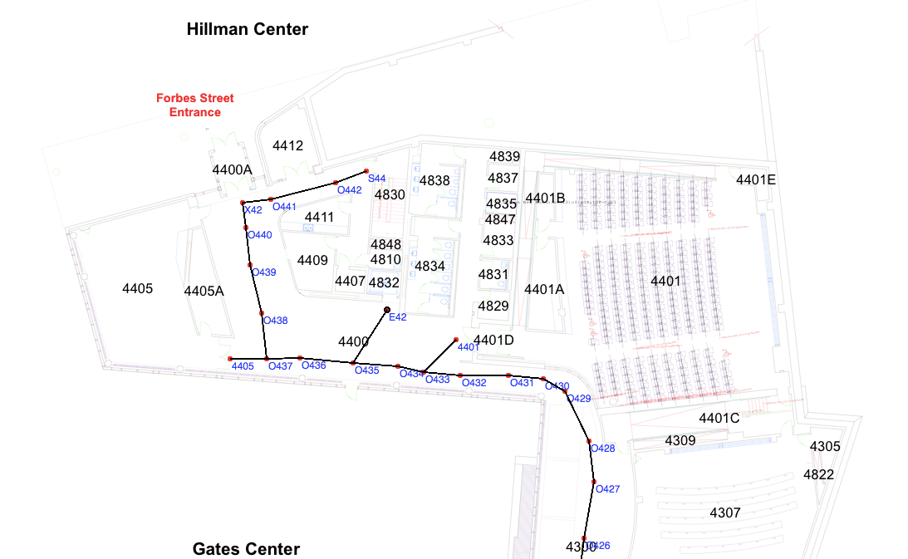
How do these different algorithms fit together?
Suppose I have a robot that can take items to different people, deliver messages, etc.
Once you have the
sequence of locations,
how does it plan a
path to each destination?
BFS

Slide 167
How do these different algorithms fit together?
Suppose I have a robot that can take items to different people, deliver messages, etc.
Once the robot has a
list of locations to
navigate, how does it
get there?
Motor motion control
Rapidly-exploring Random Trees (obstacles)

Slide 168
How do these different algorithms fit together?
Suppose I have a robot that can take items to different people, deliver messages, etc.
Hierarchical Planning:
High-level: classical
Mid-level: BFS
Low-level: motors

Slide 169
Planning, Thus Far
Goal States
completely specified
Goal Statements
partially specified
Preference models
objective function
Probabilistic States and Actions
Increasing Generality

Slide 170
Summary
Informationless states and actions
Easy to program
Can take a lot of memory
Hard to change the problem (e.g., adding a block)
Predicates and Properties
Potentially avoids the memory issues
Many alternate definitions
Need separate actions for different conditions
Other concerns like uncertainty unmodeled

Slide 172
Another Example: Getting Dressed
States?
Actions?
Goal?

Slide 173
Another Example: Robot Navigation
States?
Actions?
Goal?

